Slide 1




Optimisation at Wairakei
AKA “Optimising the well operation and steamfield configuration tracking tool at the Wairakei geothermal system”
Vida Fox
Logan Wu
Image: https://www.vectorstock.com/royalty-free-vector/geothermal-energy-concept-eco-friendly-geothermal-vector-19426193

Slide 2

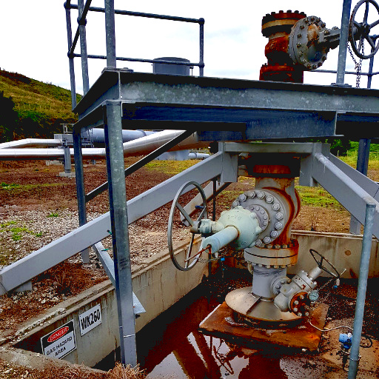
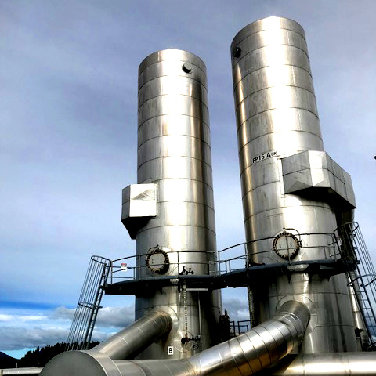
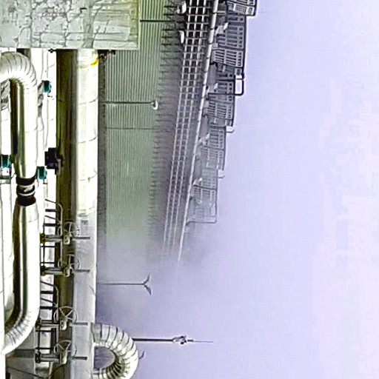
Introduction to Wairakei
70 Wells
10 Flash Plants
4 Power Plants
3 steam powered
1 water powered
Notes:
A standard commercial geothermal field has three main components:
wells , flash plants, power plants - use steam used to turn turbines that drive generators to produce electricity.
At the Wairakei steam field, owned and operated by contact energy, there is a complex network of approximately 70 wells, that feed fluid to >10 flash plants and 4 power plants (3 steam, 1 water powered/binary). //

Slide 3
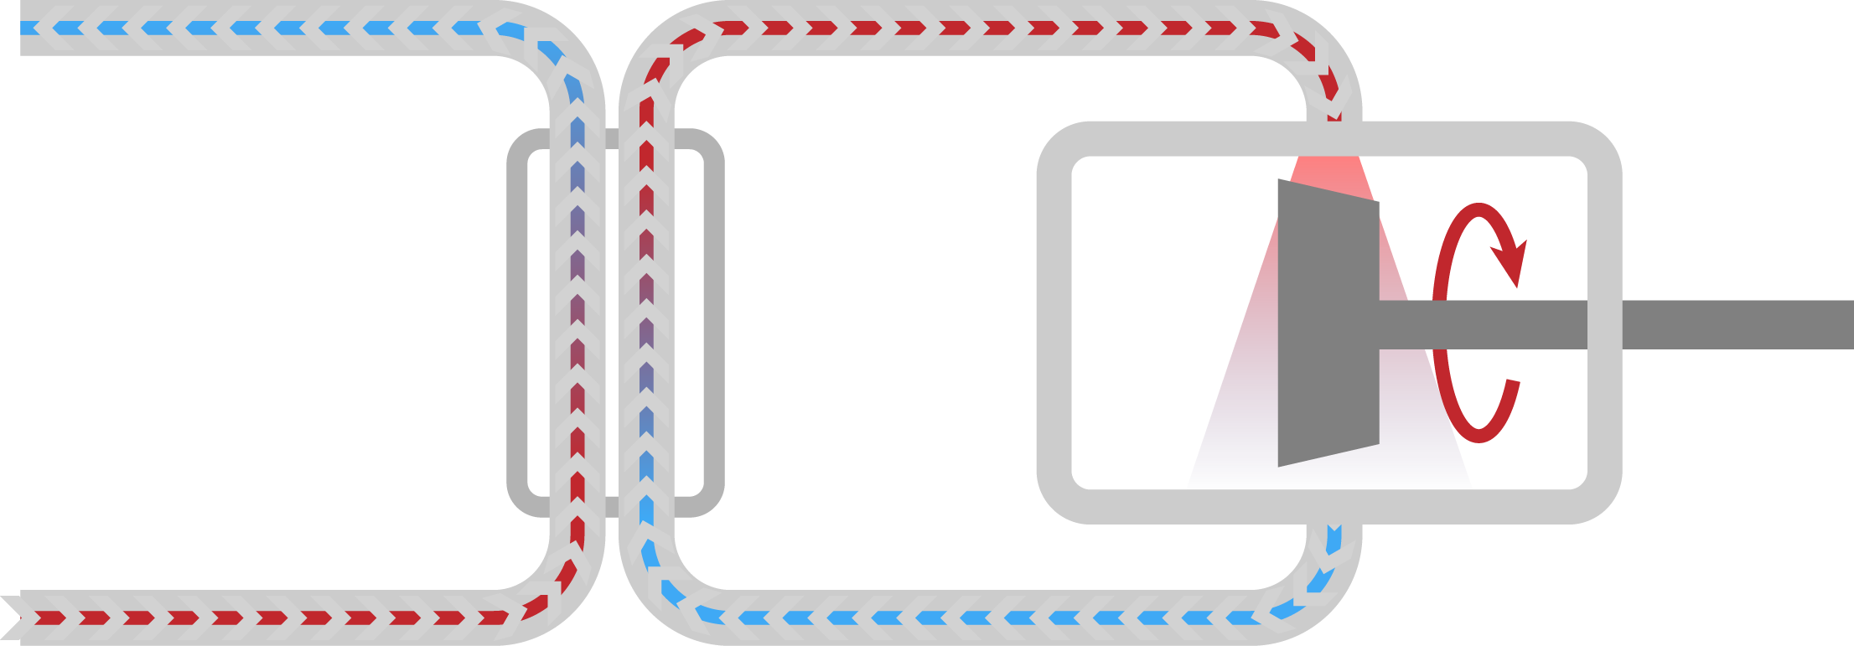
Binary Plant
Turbine
Water
Pentane
Heat exchanger
Notes:
-> The water powered plant is called a binary plant. This harnesses energy from hot separated water by using it to heat and evaporate pentane in a closed system. Once in a gaseous form the pentane turns turbines to generate electricity in the same way as steam, before being cooled and recycled.//

Slide 4
Steamfield Network
1
steam & water
FP1
steam
Power Plant 1
2
...
water
Binary Plant
...
FP2
steam
...
Power Plant 2
n
water
reinjection, prawn farm, etc
Notes:
These three key components, wells, FPs and PPs naturally form a simple network (pictured). Each FP feeds fluid to a specific power plant, however there are a selection of wells that are able to be directed to different FPs at different times. These are called swinging wells and are shown in this diagram by wells with 2 arcs, (a solid active arc and a dashed inactive arc).
As well as this, each of the power plants produces electricity from steam, or water, at different rates. And the binary plant can only take water from certain flash plants. For these reasons there is the opportunity to optimise well configuration, to maximise electricity production.//

Slide 5



Current System
Well
FP
Data & Workbooks
Operator
Field Team
Gen
Notes:
Currently decisions concerning well configuration are made using data in a series of Excel workbooks. It is quite a manual process based on rules of thumb, and staff expertise.
This poses a number of challenges; there is no guaranteed optimality, the spreadsheets are slow, there is a lack of transparency, and data values are prone to a margin of error.//

Slide 6
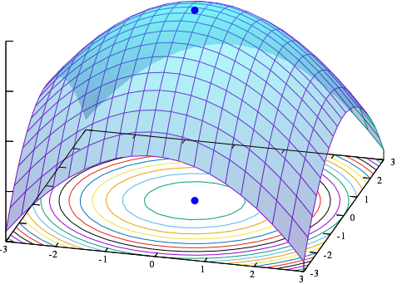
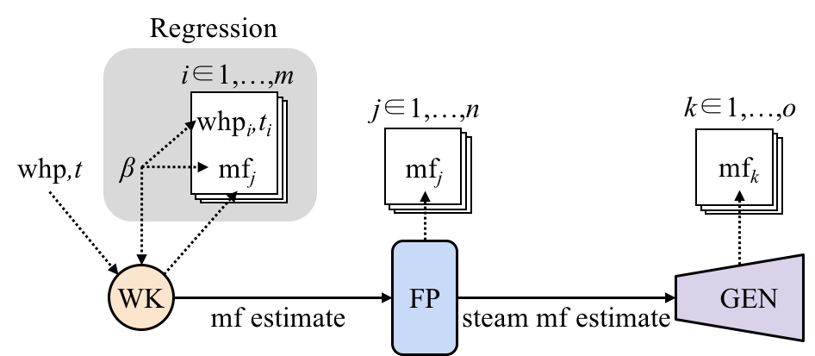
Project Division
Vida | Logan
Integer programming Decision optimisation | Bayesian simulation Uncertainty
Image: https://commons.wikimedia.org/wiki/File:Max_paraboloid.svg
Notes:
Our solution to these challenges has two parts. I created a mixed integer linear program to optimise the configuration of a subset of the Wairakei steam field. And Logan has used Bayesian modelling to take into account uncertainty in our data and parameter values.

Slide 7
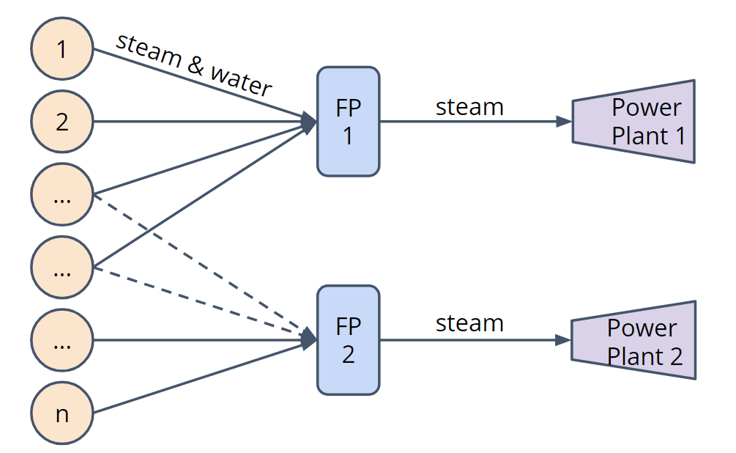
Optimisation
Subset of Steamfield network:
35 wells - mass flow, enthalpy.
4 flash plants (FP) - pressure, enthalpy of water/steam.
4 power plants - efficiency factor (gives MW).
Assumptions:
Independence - rest of steam field doesn’t affect this region.
Measurements/data are accurate at given time.
Notes:
To create my mixed integer linear program, I used a subset of the steam field. This subset contains 35 wells, 4 FPs and all PPs at Wairakei. Within this is all swinging wells, and hence all wells where decisions can be made for the steamfield configuration.
Several assumptions have to be made to model this system, the key ones being that the state of the rest of the steamfield doesn’t affect this region, and that the values used are accurate at the given time.
The important data values needed to model this system are: the mass flow and enthalpy of the fluid coming out of each well, the pressures in each flash plant and the enthalpy of water and steam at those pressures, and the efficiency factor of each power plant. These values, all provided to us by Contact Energy, allow us to calculate the amount of steam or water going into each power plant, and convert this to a number of MW generated.//

Slide 8
Steamfield Network
1
steam & water
FP1
steam
Power Plant 1
2
...
water
Binary Plant
...
FP2
steam
...
Power Plant 2
n
water
reinjection, prawn farm, etc
Notes:
The goal of this model is to choose an optimal configuration of swinging wells to maximise electricity production. Previously, I showed you this network diagram, now let’s look at this for a single well.

Slide 9
Steamfield Network
FP1
steam
Power Plant 1
steam & water
Well
water
Binary Plant
steam & water
FP2
steam
Power Plant 2
water
reinjection, prawn farm, etc.
Notes:
We want to decide whether to swing this well to FP1 or FP2.//

Slide 10
Steamfield Network
FP1
steam
Power Plant 1
steam & water
Well
water
Binary Plant
steam & water
FP2
steam
Power Plant 2
water
reinjection, prawn farm, etc.
Notes:
If we swing it to FP1, making this arc active, we can use both its water and steam to produce electricity because FP1 connects to the Binary Plant. //

Slide 11
Steamfield Network
FP1
steam
Power Plant 1
steam & water
Well
water
Binary Plant
steam & water
FP2
steam
Power Plant 2
water
reinjection, prawn farm, etc.
Notes:
But, FP2 goes to PP2 which may produce electricity from steam at a higher rate.//

Slide 12
Steamfield Network
FP1
steam
Power Plant 1
steam & water
Well
water
Binary Plant
steam & water
FP2
steam
Power Plant 2
water
Proportions of steam and water depend on enthalpy.
reinjection, prawn farm, etc.
Notes:
Now this well, might have high or low enthalpy, where a higher enthalpy means its fluid will contain a larger proportion of steam, so we might chose to swing the well to FP2, where steam goes on to the more efficient steam powered plant. //

Slide 13
Steamfield Network
FP1
steam
Power Plant 1
steam & water
Well
water
Binary Plant
steam & water
FP2
steam
Power Plant 2
water
Different Pressures
reinjection, prawn farm, etc.
Notes:
Each FP operates at a different pressure, which also affects the amount of steam that gets sent into the power plants. These are all factors included in my model.//

Slide 14
Decision Variables
FP1
steam
Power Plant 1
steam & water
Well
water
Binary Plant
steam & water
FP2
steam
Power Plant 2
2 Decision Variables for each arc:
- binary variable ∈ {0,1}
- continuous variable ∈ (0,1)
water
reinjection, prawn farm, etc.
Notes:
This swinging well decision is represented by a pair of decision variables for each arc. A binary decision variable and a continuous decision variable. The binary variable represents whether or not a given arc is active, that is whether the flow from the well is swung to a given FP. The continuous variable is between 0 and 1 and represents the percentage of the mass flow of the well that is allowed to flow (throttling).//

Slide 15
Objective Function
FP1
steam
Power Plant 1
steam & water
Well
water
Binary Plant
steam & water
FP2
steam
Power Plant 2
MW produced = Sum of steam/water into each power plant divided by the efficiency factor for the given power plant
water
reinjection, prawn farm, etc.
Notes:
The Objective Function here is to maximise the number of MW of power produced by the steamfield. This is calculated as the sum of the steam/water into each power plant divided by the efficiency factor for that plant.

Slide 16
Constraints
FP1
steam
Power Plant 1
steam & water
Well
water
Binary Plant
steam & water
FP2
steam
Power Plant 2
water
reinjection, prawn farm, etc.
Notes:
I have used 4 constraints for my model, I consider these the main constraints on the system though there are numerous others that could be included.

Slide 17
Constraints
FP1
steam
Power Plant 1
steam & water
Well
water
Binary Plant
steam & water
FP2
steam
Power Plant 2
3 Constraints:
- One active arc per well
- Flow along active arc ⩽100%
- Flow along active arc ⩾
specified minimum flow
water
reinjection, prawn farm, etc.
Notes:
There are 3 constraints relating to the arcs between wells and FPs.
The first is that a maximum of one arc from each well can be active, that is, a well can only be connected to one FP at a time.
The second ensures that flow along an active arc is less than 100% of the full capacity mass flow of the well.
The third allows the user of this model to set a minimum flow for all or some of the wells.

Slide 18
Constraints
FP1
steam
Power Plant 1
steam & water
Well
water
Binary Plant
steam & water
FP2
steam
Power Plant 2
- Conservation of Mass
- Sum of steam into FPs ⩽ steam
flow limit of FPs
water
reinjection, prawn farm, etc.
Notes:
Finally, each flash plant has an operational limit on the amount of steam that can pass through it, this gives us our fourth constraint that the sum of the steam flow out of each FP must be lower than this limit.

Slide 19
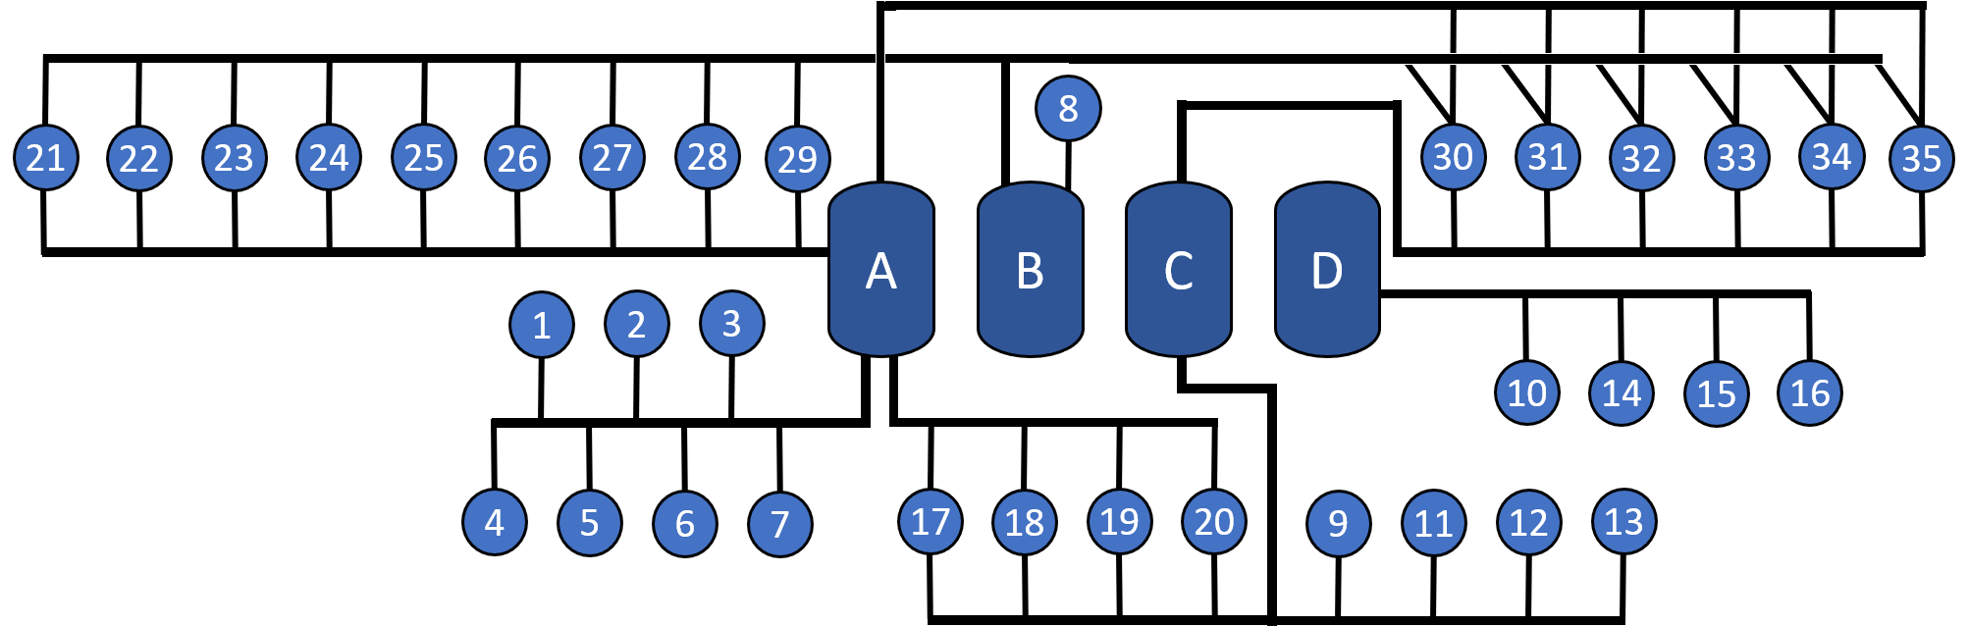
Subset Network
Notes:
The culmination of decision variables, constraints and the objective function, as I have described, was formulated and solved in Excel using OpenSolver.
The subset of the steamfield I modelled, with 35 wells, is represented on this diagram, where wells are numbered 1-35 and FPs labelled A-D.

Slide 20
Subset Network
Notes:
Each line leaving a well, like this one, is an arc in the network

Slide 21
Subset Network
Notes:
a well that can be swung to 2 FPs has 2 arcs

Slide 22
Subset Network
Notes:
and one that can be swung to 3 has 3.

Slide 23
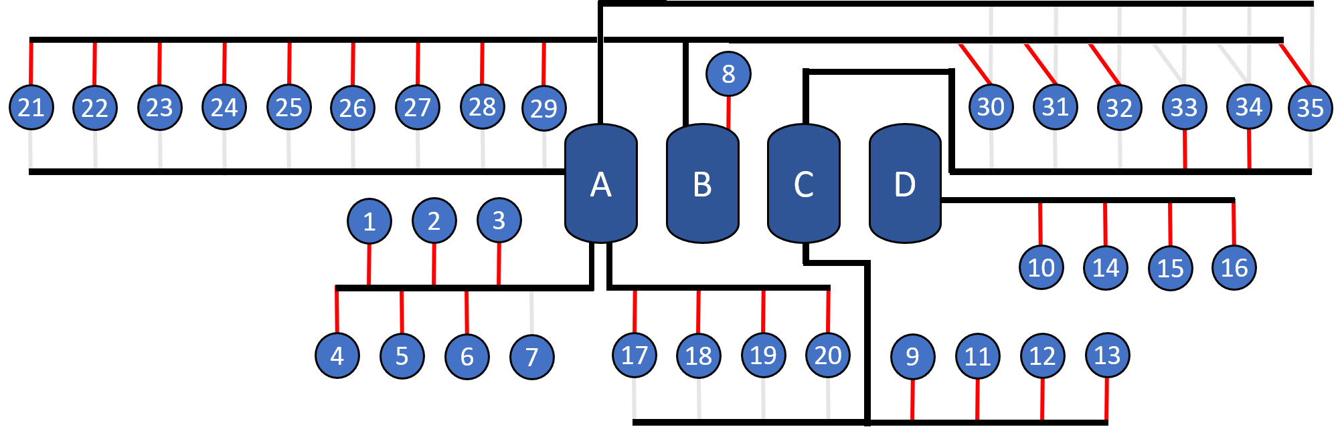
Actual Configuration - 1 Dec 2017
Active Arc
Inactive Arc
Notes:
The data provided to us that I used for this model was for the 1 December 2017. On this day Contact was operating with this configuration.

Slide 24

Optimised Configuration
Active Arc
Inactive Arc
Notes:
When I solved my model, this was the optimal configuration. As you can see, very little has changed.

Slide 25

Actual vs Optimised Configuration
Active Arc
Inactive Arc
Was Active
Notes:
In fact, only three wells have been swung differently in the optimised configuration, wells 17, 19 and 33.

Slide 26

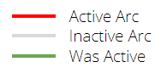
Actual vs Optimised Configuration
More fluid to FP B & C.
FP B & C feed to more efficient power plants.
This maximises electricity produced.
May not be practical to operate so close to the FP steam limits.
The true configuration is very similar.
Notes:
This makes sense because it results in more fluid going to FPB and C which connect on to the more efficient power-plants. However, this optimised configuration results in FPB and C operating at, or close too, their steam flow limits. It may not be practical to operate so close to the flash plant steam limits, hence there may be good reason for the less optimal true configuration.

Slide 27
Results of LP
Actual Configuration - 279.5 MW.
Optimised configuration - 286.0 MW.
6.5 MW / 2.3% increase in electricity production.
⩾75% of average contribution of a well
Model could be a good tool to help steamfield configuration decisions.
286 MW optimised
279.5 MW actual
Total Power

Slide 28
Future Work for LP
Expansion to whole steamfield.
Allows inclusion of different constraints.
Expansion to include wastewater flows.
Re-injection, river, other uses.
Simulate with many different sets of data.
Combine with Bayesian Modelling
Notes:
There are a number of areas of potential future work for this model. It could be extended to the whole steamfield, which would allow additional constraints to be added such as maximum total mass take, or environmental constraints. The waste water network, where geothermal water is reinjected into the ground, sent to the Waikato river or held in ponds, could by modelled. Or we could run simulations with the model using many different sets of data and parameters, in order to understand the sensitivity of the steamfield.
As Logan will discuss later, this model could also be integrated with his Bayesian Model.
All of these options would further extend the capabilities of my model as a decision-making tool.
I will now hand you over to Logan to talk about Bayesian modelling.

Slide 29

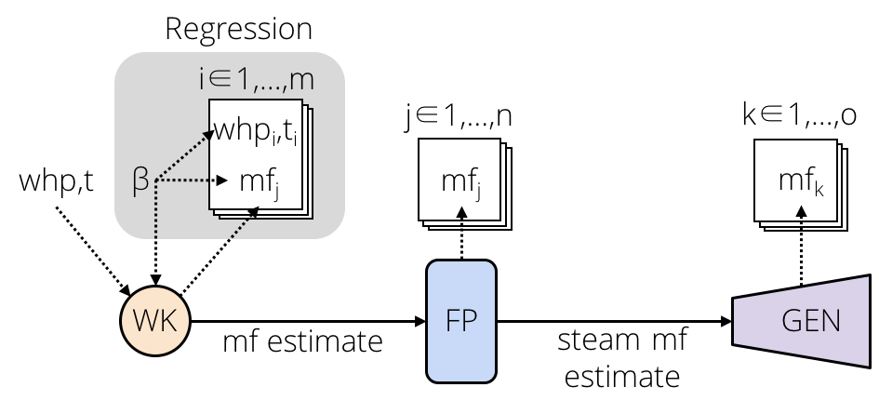
Simulation
Uncertainty and risk
Bayesian simulation
Measurements contain error
Parameters contain uncertainty
image: The Matrix (1999)

Slide 30
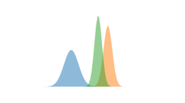
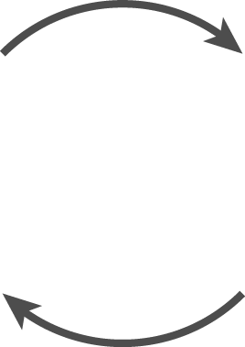
Missing Data
Hierarchical model
Missing wells imputed from a distribution
Parameter distribution
Unobserved well
Observed wells

Slide 31
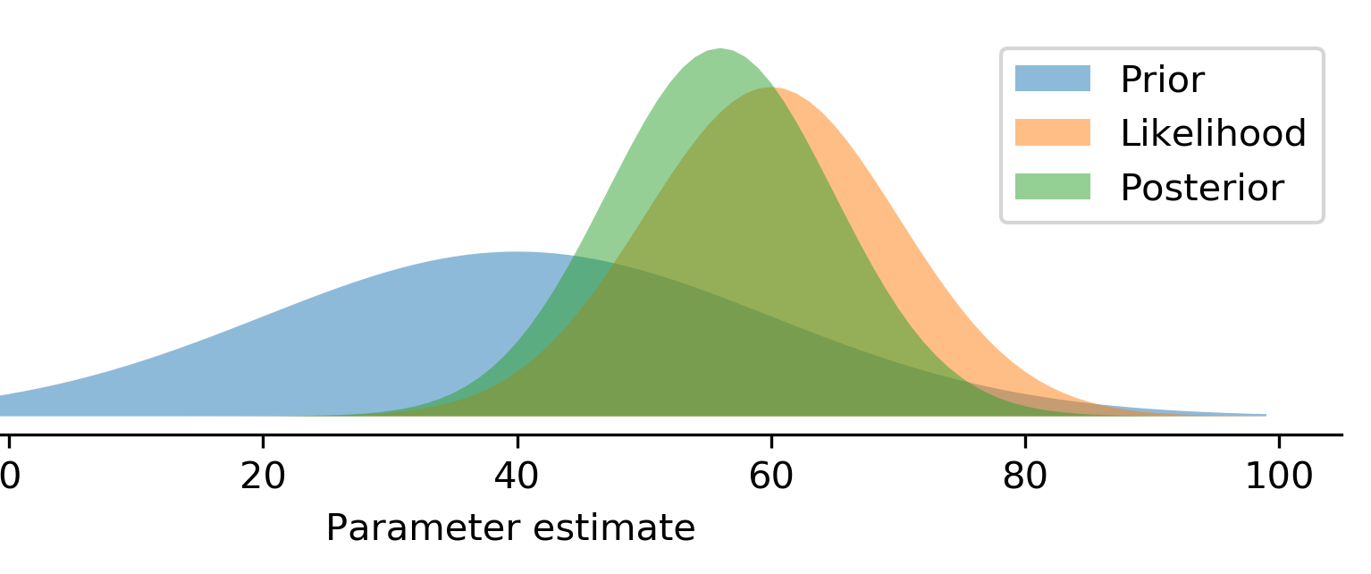
Statistical Method
Bayesian simulation
Prior x Likelihood = Posterior
RJAGS

Slide 32
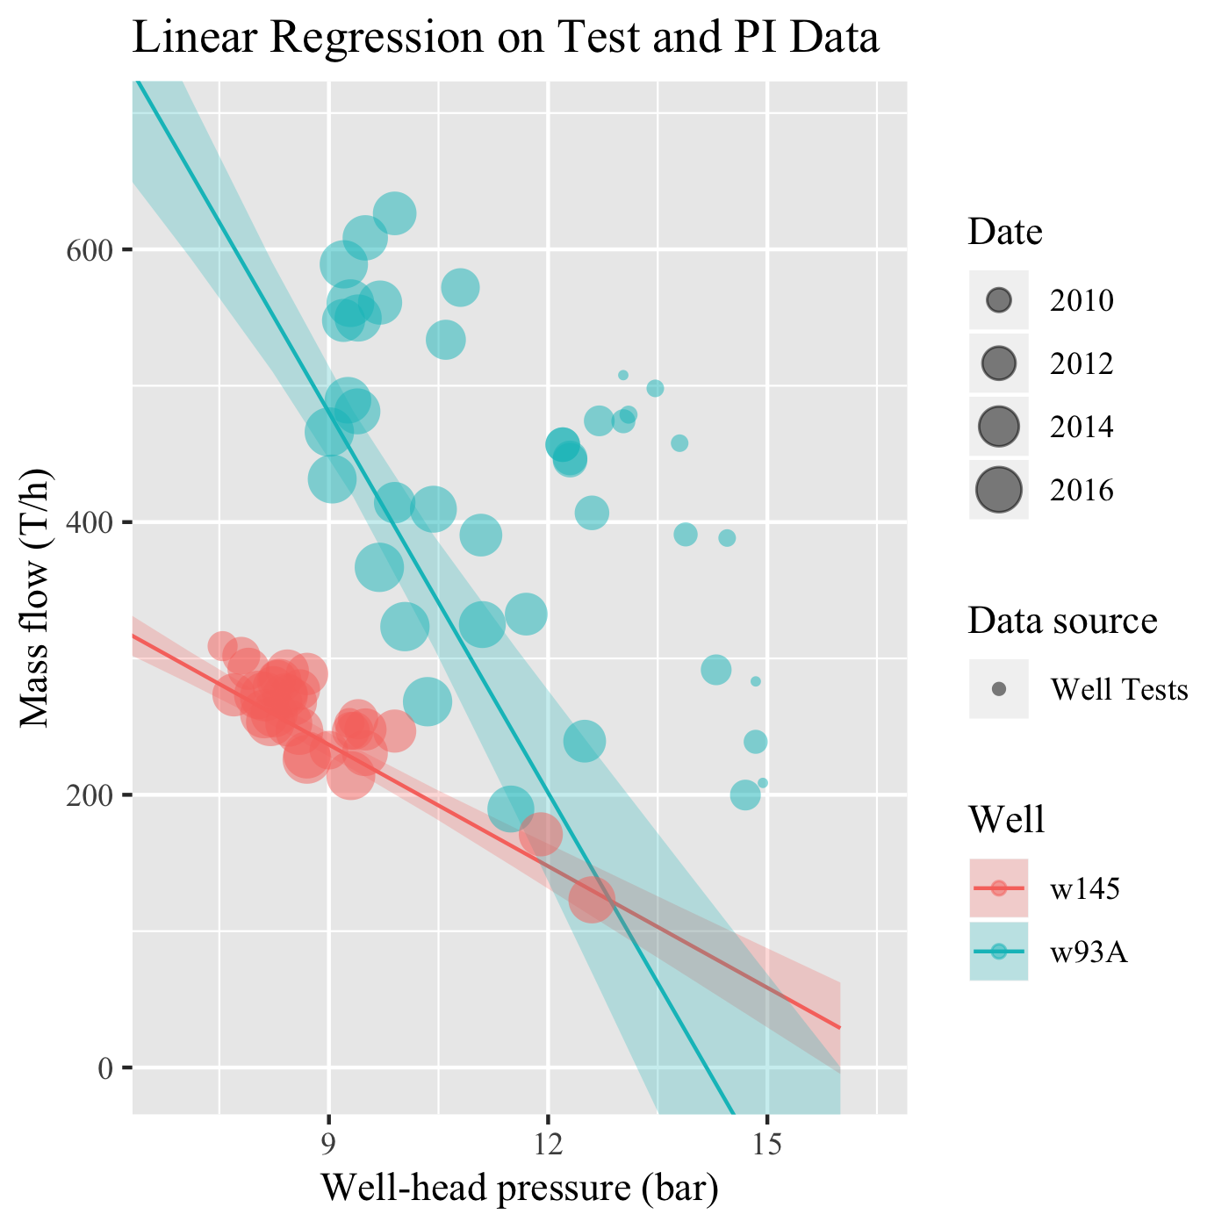
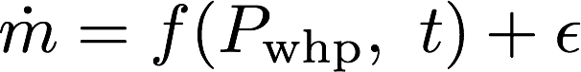
Simulation Process
Wells

Slide 33
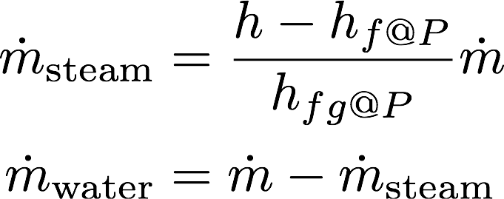
Simulation Process
Physical transformations
steam
Flash Plant
mixed phase
water

Slide 34
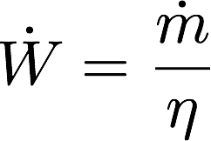
Simulation Process
Physical transformations
Steam
Generator
Water

Slide 35
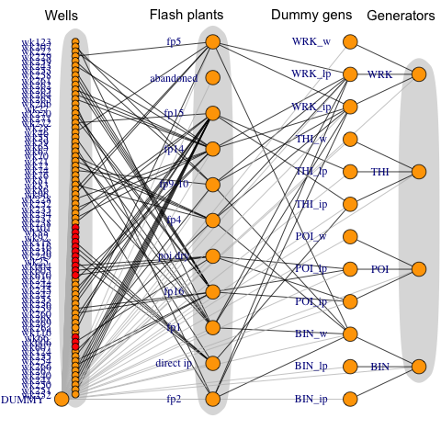
Full Network
~6000-dimensional

Slide 36
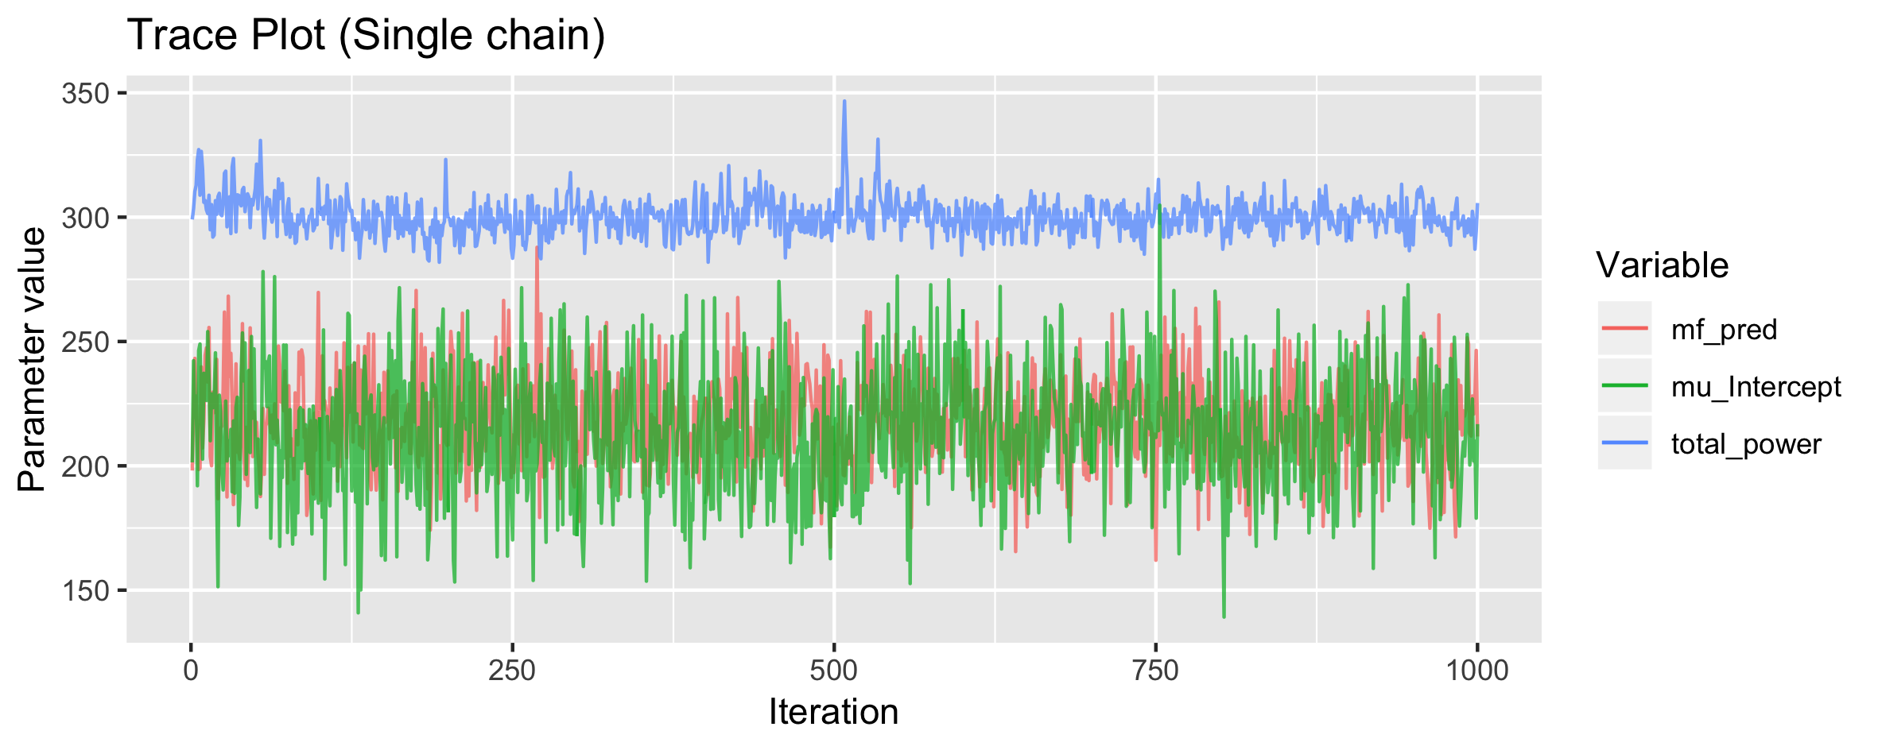
Simulation Process
Simulate the posterior with Gibbs Sampling

Slide 37
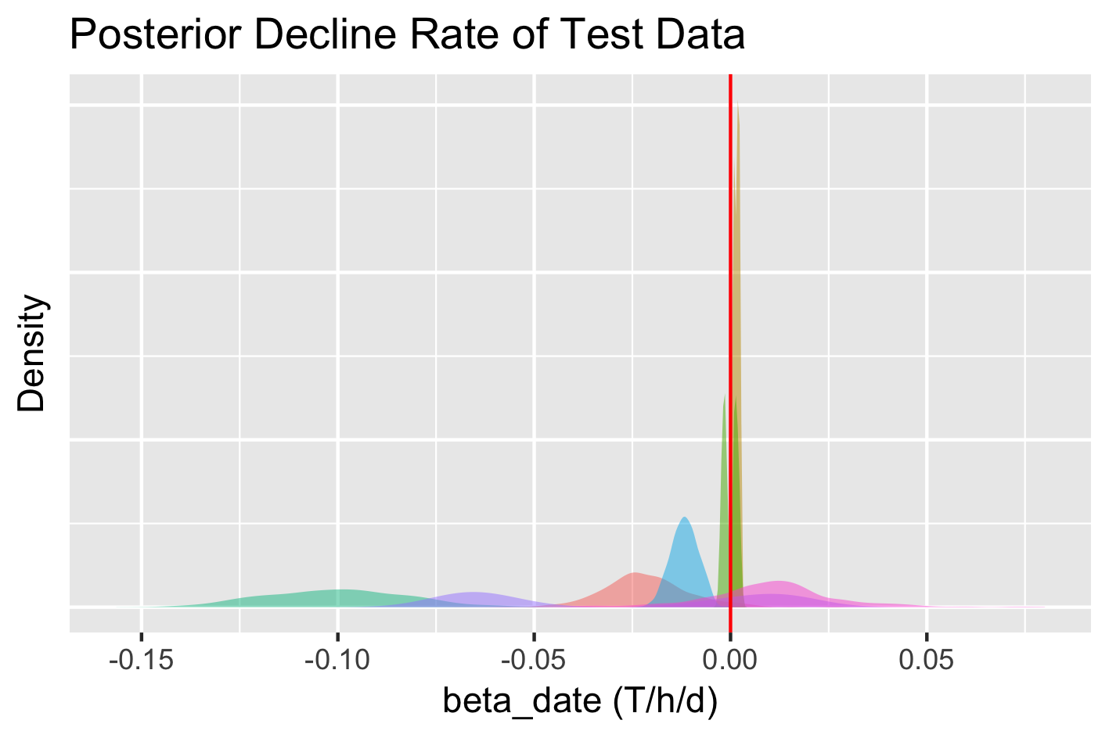
Simulation Results

Slide 38
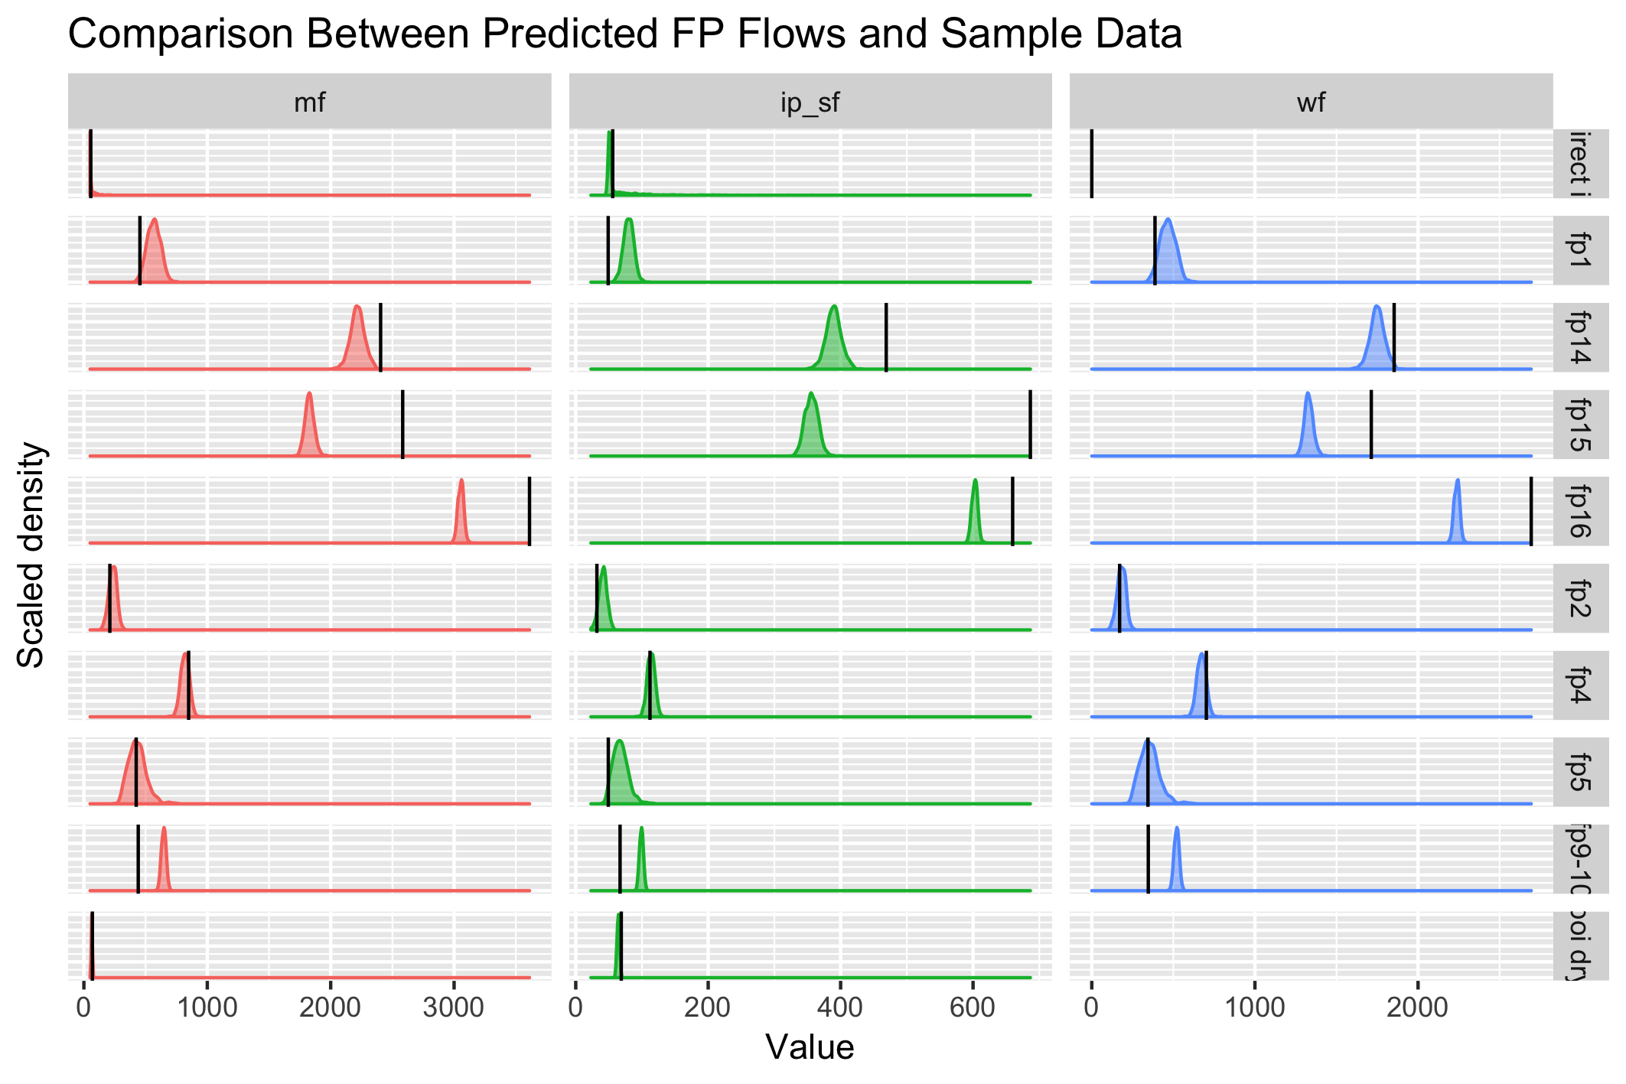
Simulation Results

Slide 39
Simulation Results
Find probability of constraint violation
FP14
FP15
FP16
<0.01%
<0.01%
<0.01%

Slide 40
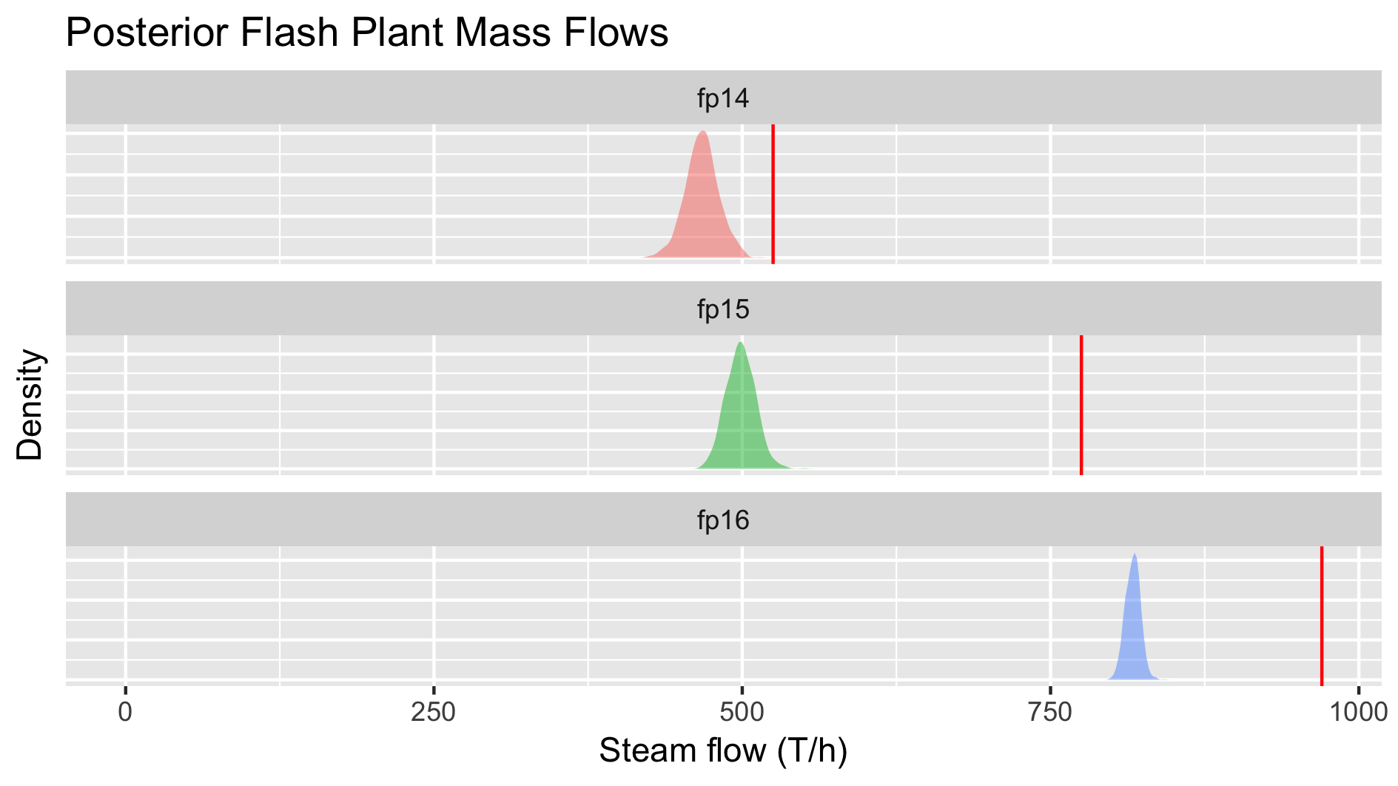
Simulation Results

Slide 41
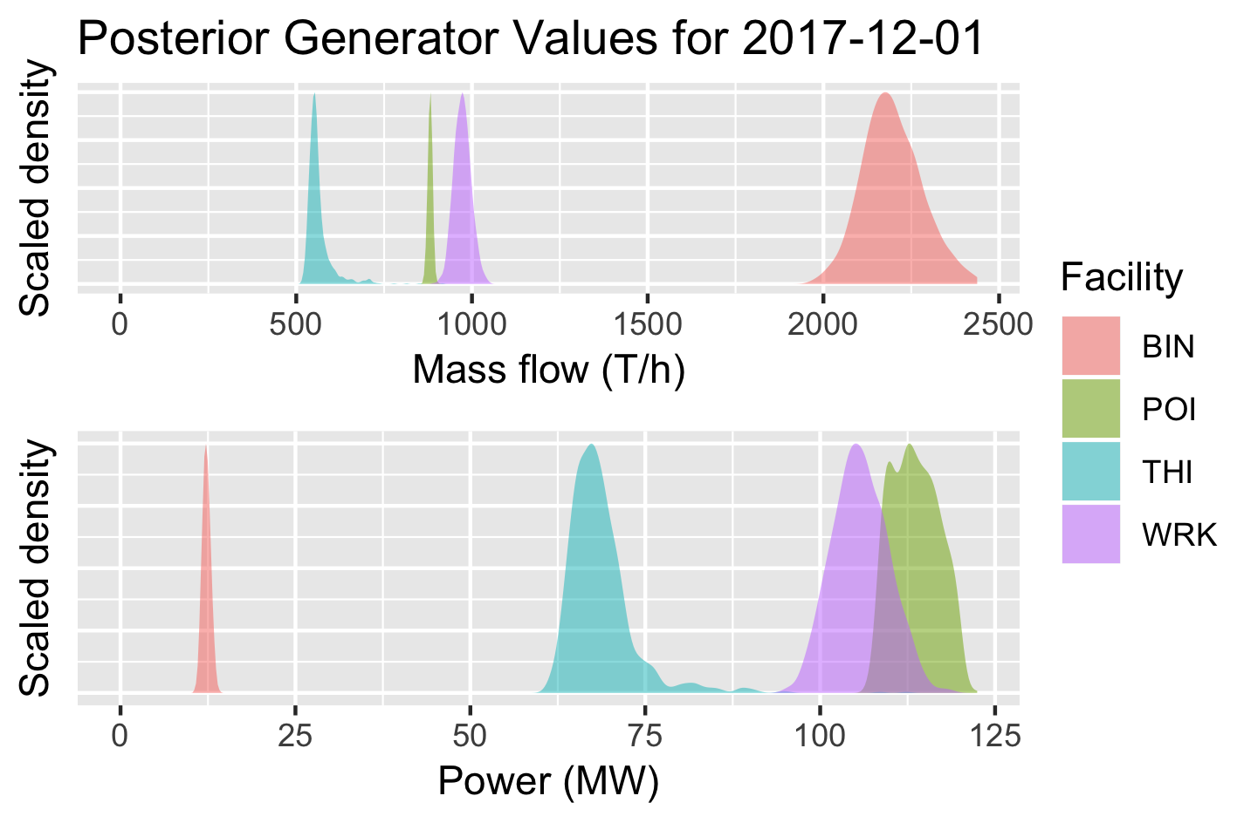
Simulation Results

Slide 42
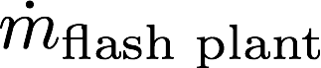
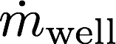
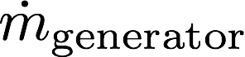
Future Work
Integrate more data

Slide 43
Future Work
Combine LP and Simulation
Compare top n LP policies
Linear program
Stochastic simulation
All possible policies
Top n policies
Ranked policies
?
1
?
2
?
3

Slide 44
Future Work
Environmental constraints
Reinjection modelling and constraints
Soft constraints

Slide 45
Limitations
Model only includes surface network, no subsurface interactions
Offline: not linked to production database
Sensitive to systematic error

Slide 46
Conclusions
Two models
Contact’s configuration is similar to our optimisation
We implement uncertainty and risk estimates
Can always use more data

Slide 47
Thank you
Questions?

Slide 48
Steamfield Network
1
steam & water
FP1
steam
Power Plant 1
2
...
water
Binary Plant
...
FP2
steam
...
Power Plant 2
n
water
reinjection, prawn farm, etc
Notes:
Decision - which wells to send where

Slide 49
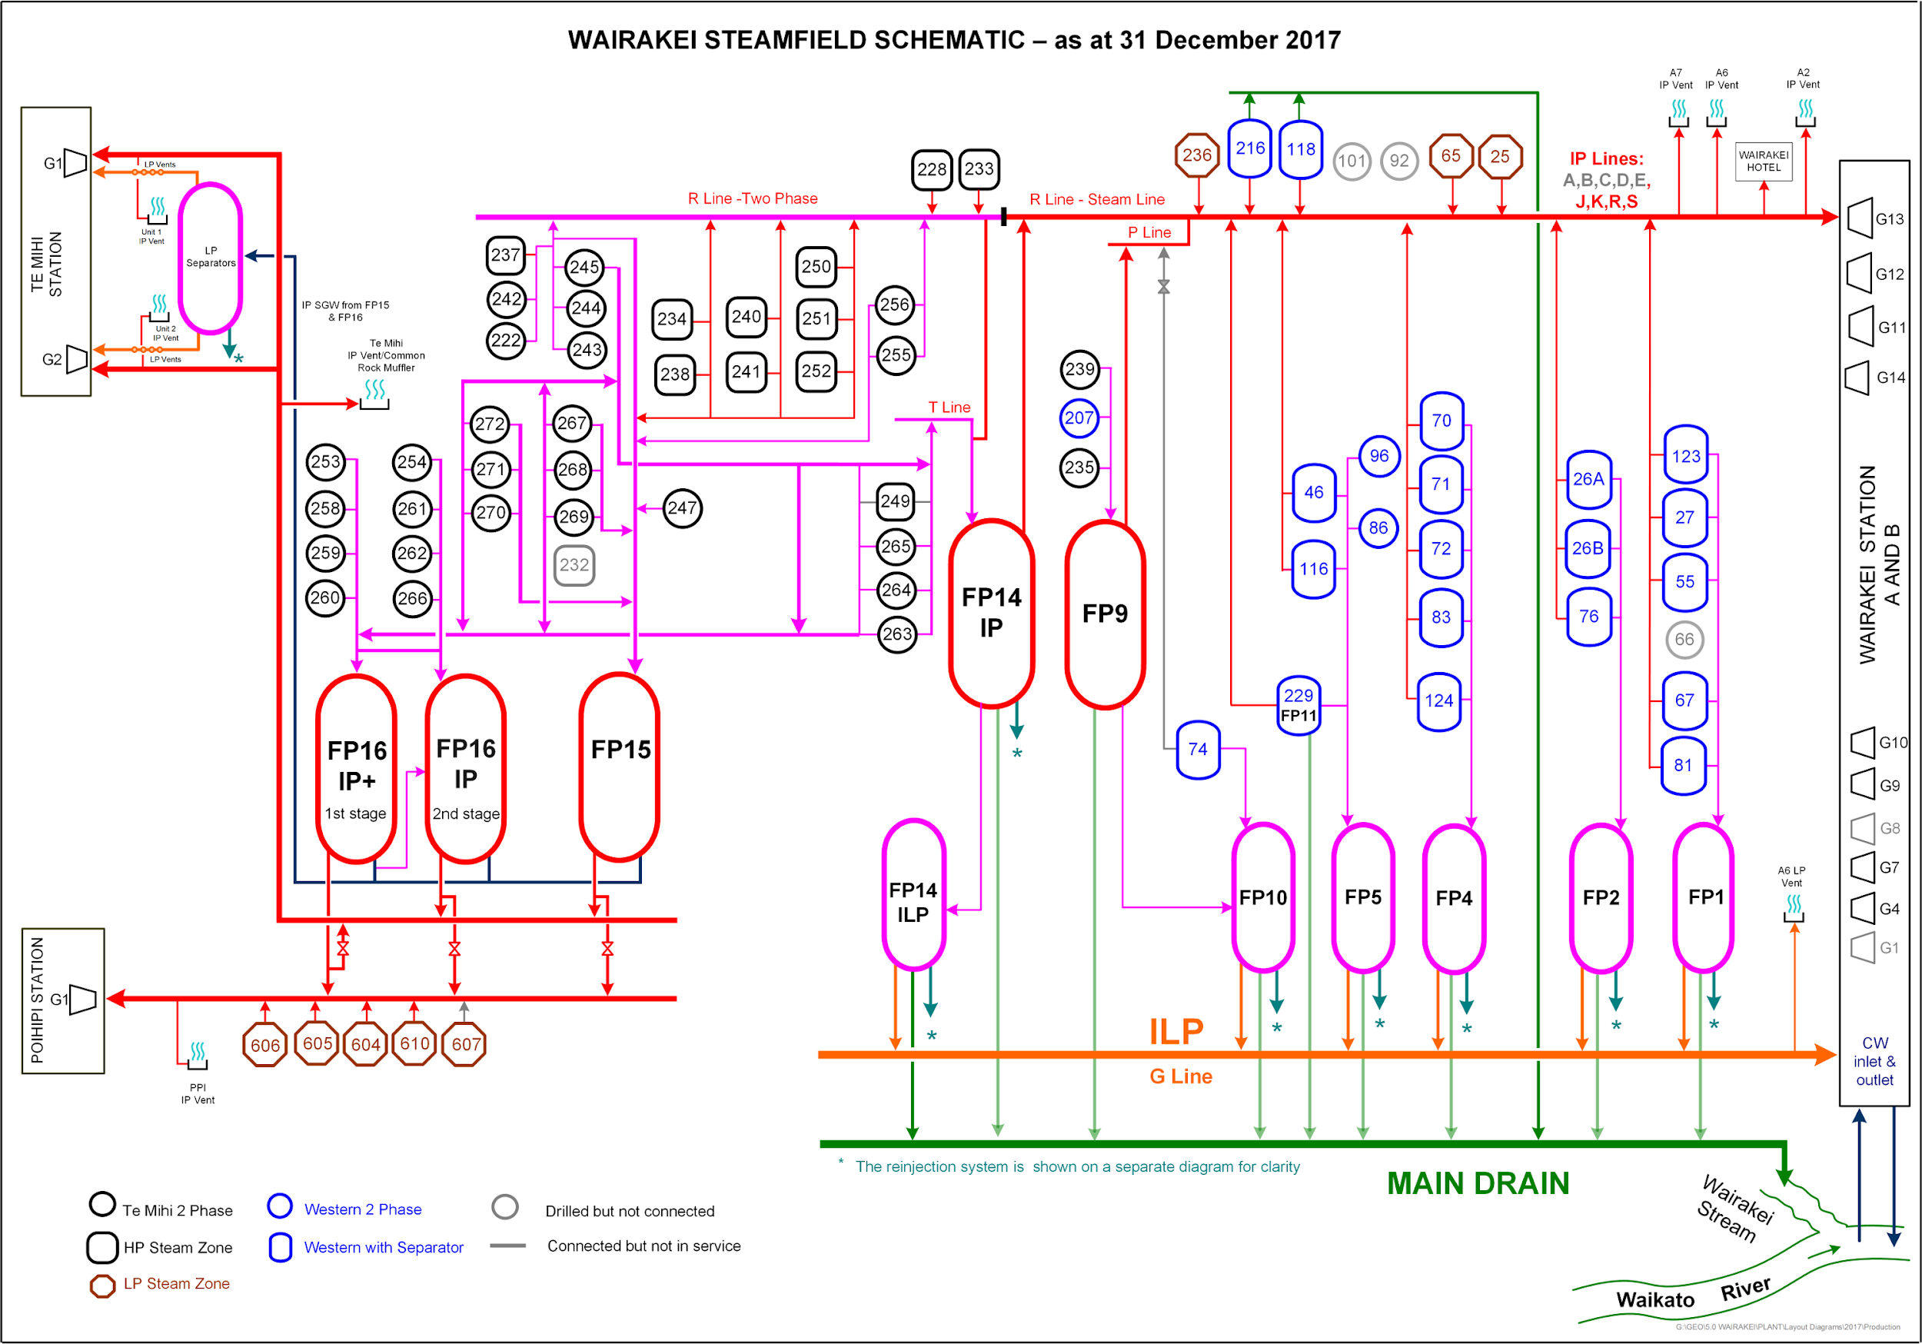
Bonus 1

Slide 50
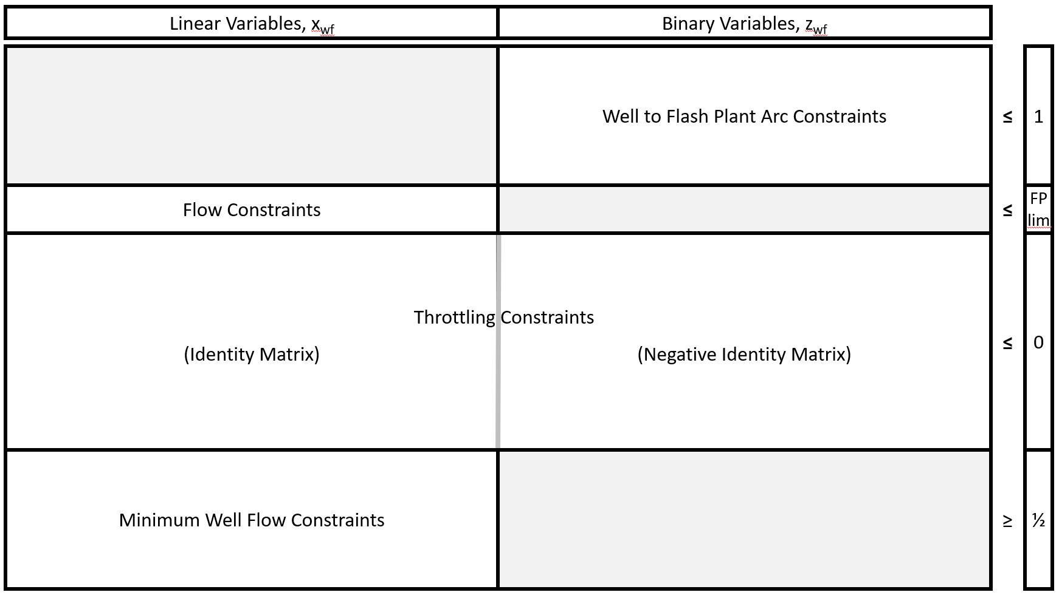
Mixed Integer Linear Program Formulation

Slide 51
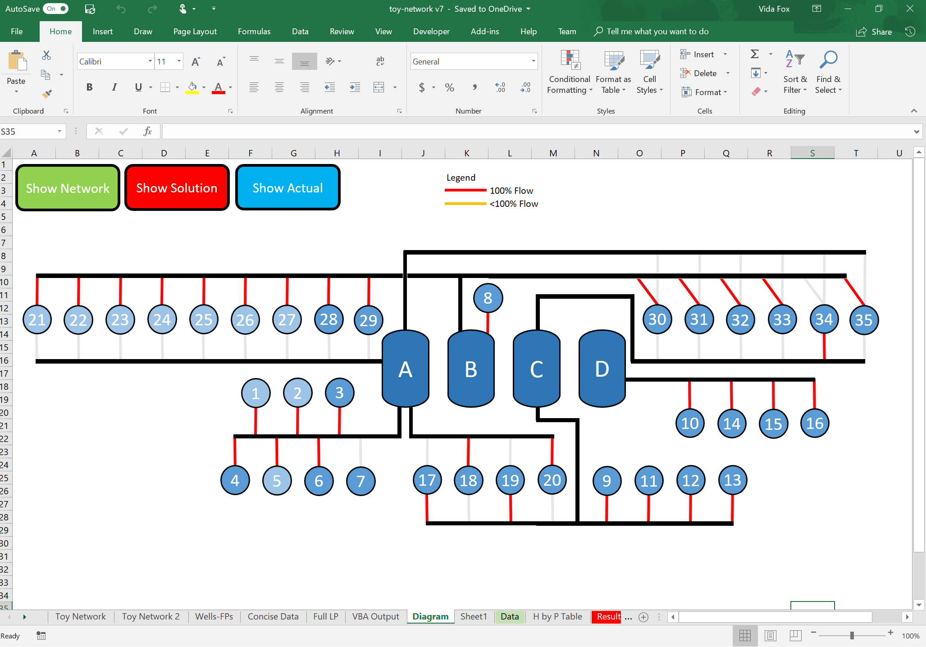
Mixed Integer Linear Program Formulation

Slide 52
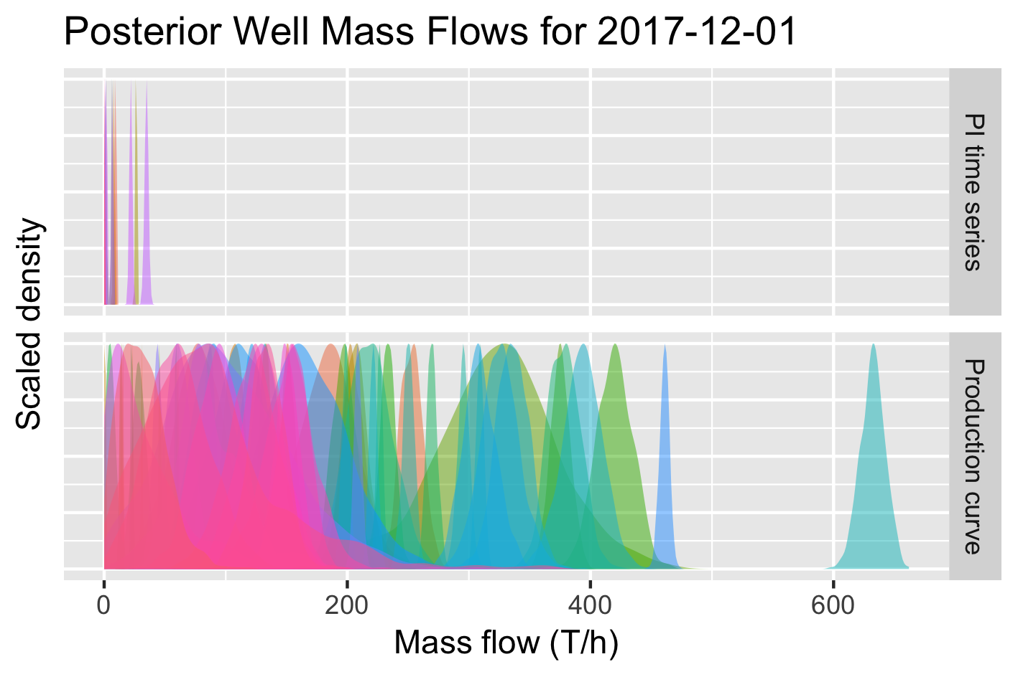
Simulation Results
“Filler” time-series wells

Slide 53
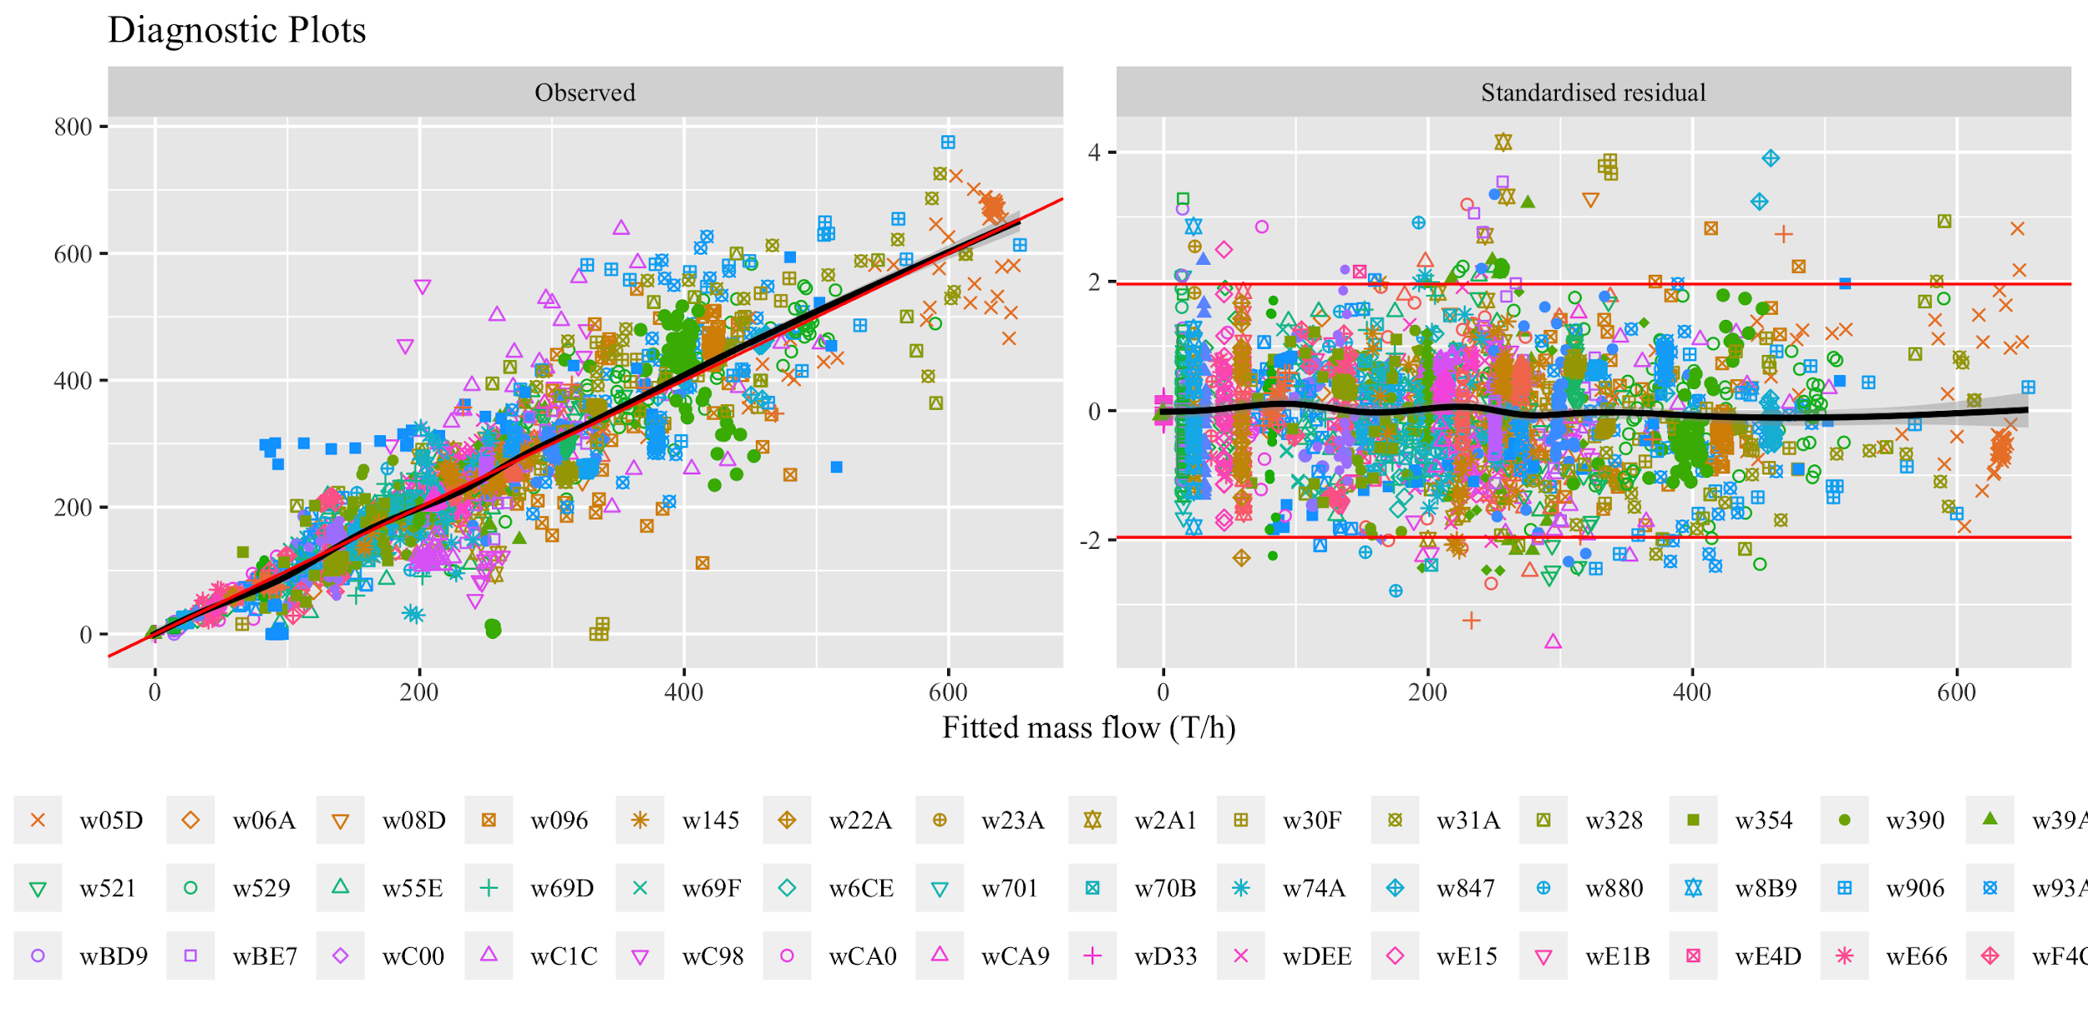
Regression Diagnostics

Slide 54
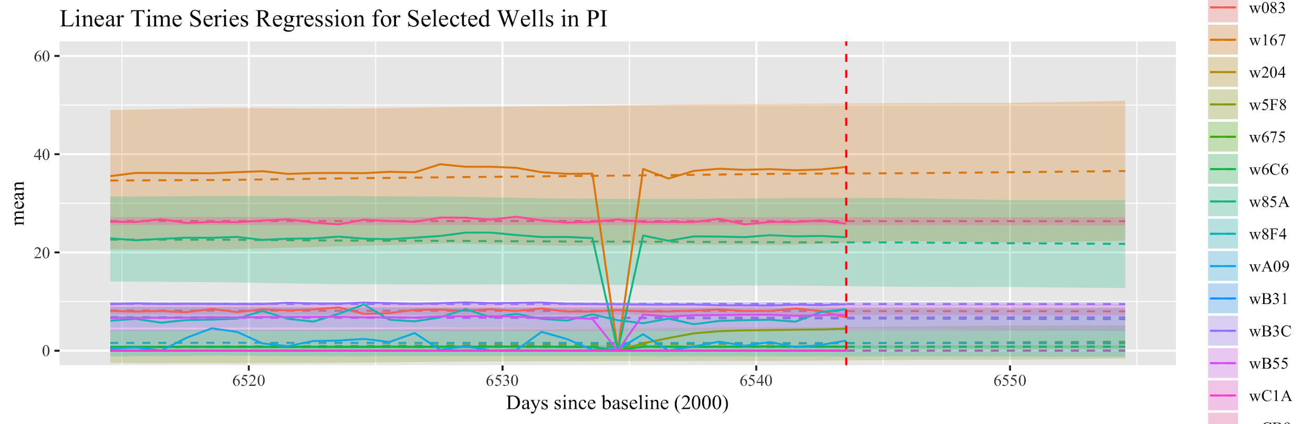
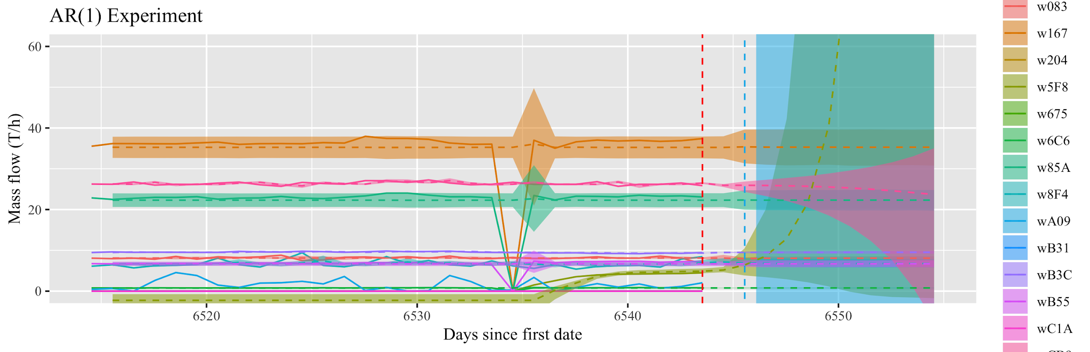
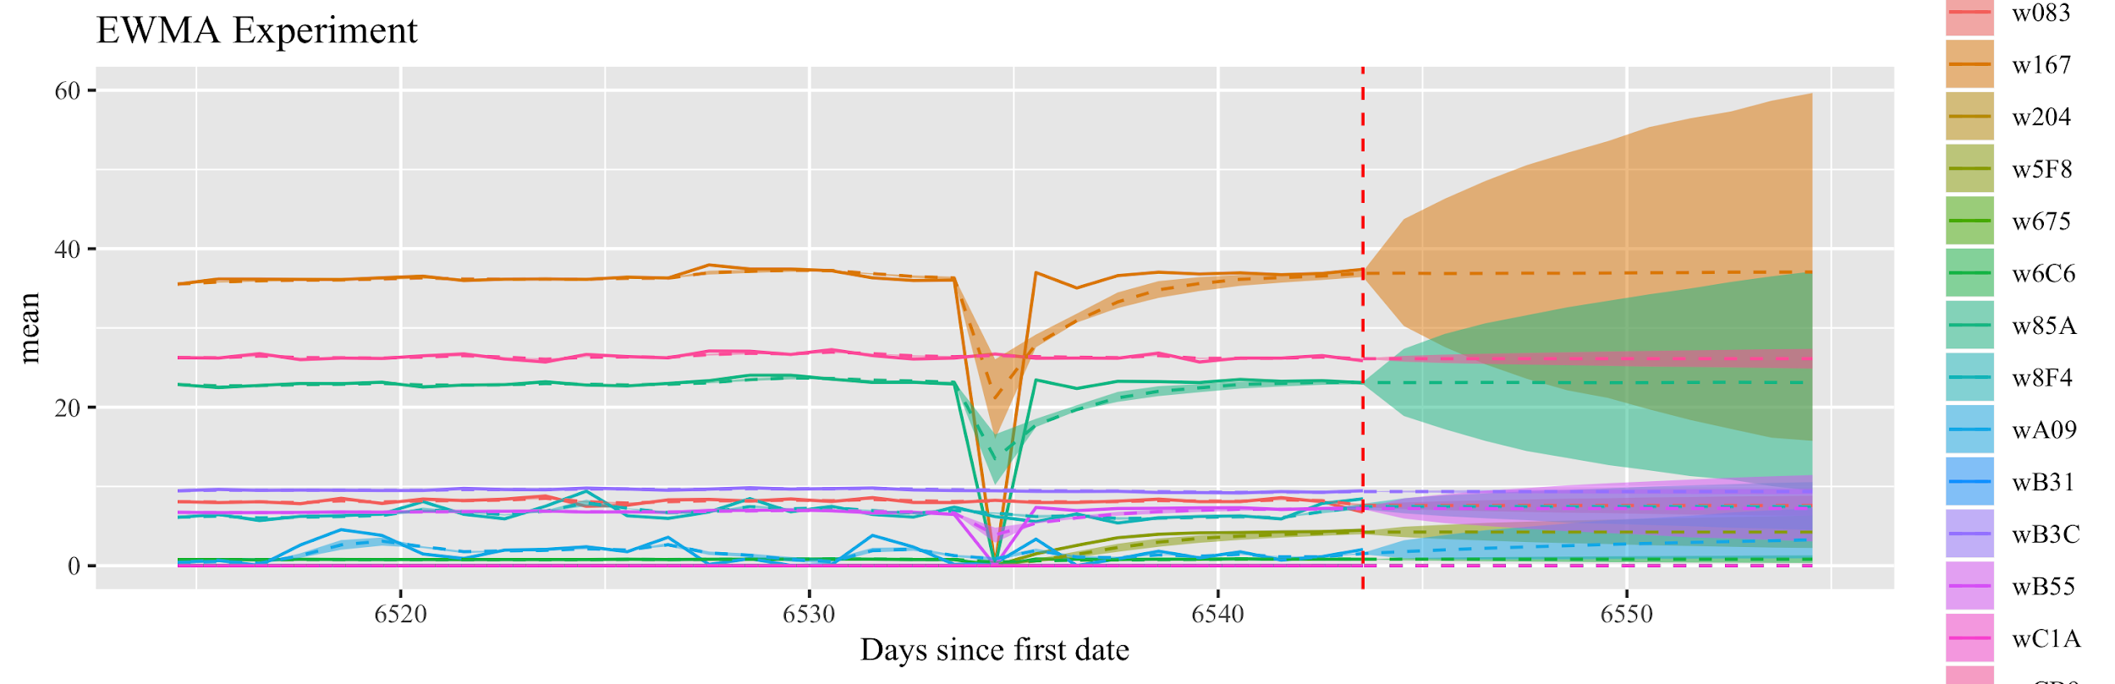
Time-series Comparison

Slide 55
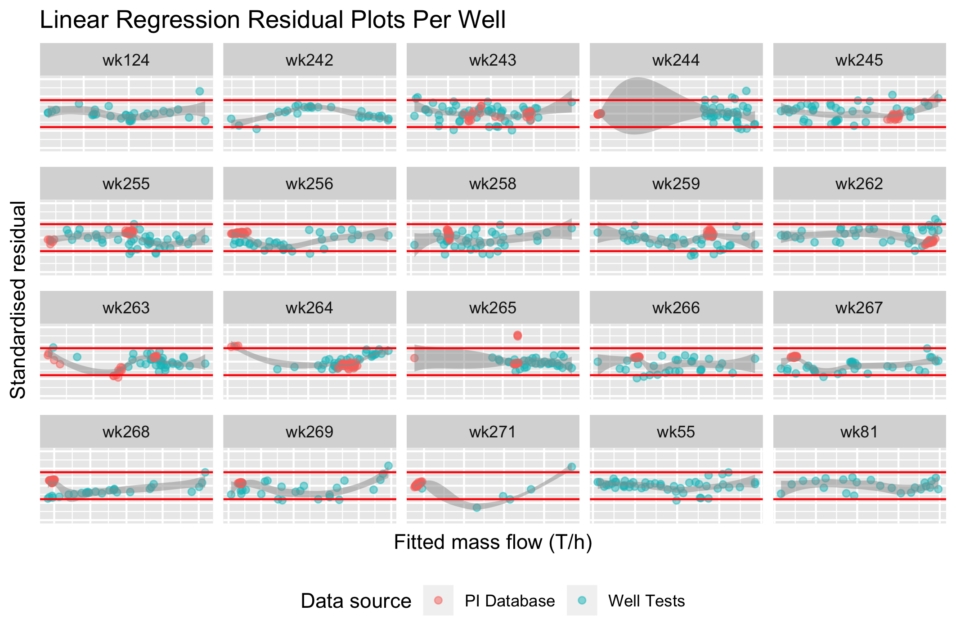
Diagnostics

Slide 56
Linear Program of Steamfield
Decision Variables: Binary & non-binary for each arc
Objective Function - Maximise MW:
Sum of steam/water into each power plant ÷ by efficiency factor.
Constraints:
Number of active arcs from each well <=1 (each well to one FP).
Flow along an active arc is <=100% of full mass flow of well.
Sum of steam into each FP is less than steam limit of FP.
A minimum level of flow for wells, where specified.
Notes:
too busy - break it up

Slide 57
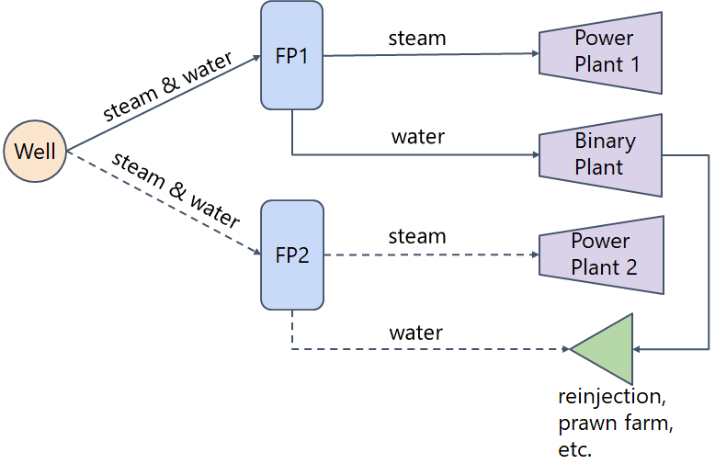
Constraints
3 Constraints:
- One active arc per well.
- Flow along active arc ⩽100%.
- Flow along active arc ⩾
specified minimum flow.
1 Constraint:
- Sum of steam into FPs ⩽ steam
flow limit of FPs
Notes:
Decision - which wells to send where

Slide 58
Results of LP
286 MW optimised
279.5 MW actual
6.5 MW / 2.3% increase in electricity production.
⩾75% of average contribution of a well
Model could be a good tool to help steamfield configuration decisions.
Total Power

